Slide 1
HTML5 Mobile Development

Slide 2
Contents
Getting started with HTML5 mobile
Creating a mobile user interface
Managing data
Implementing UI behaviour
Demos folder:
Demos\E-MobileDev

Slide 3
1. Getting Started with HTML5 Mobile
HTML5 and mobile platforms
HTML5 mobile web frameworks
jQuery Mobile
Wink Toolkit
Sencha Touch
Nimblekit

Slide 4
HTML5 and Mobile Platforms
One of the key driving factors behind the emergence and rapid adoption of HTML5 has been mobile platforms
Many of the technical features in HTML5 are ideal for mobile applications
Geolocation
Multithreading
Local storage
Offline working
Websockets
Audio and video
Etc.

Slide 5
HTML5 Mobile Web Frameworks
There are several excellent HTML5 mobile web platforms available
For example:
jQuery Mobile
Wink Toolkit
Sencha Touch
Nimblekit
We'll take a quick look at each of these on the following slides

Slide 6
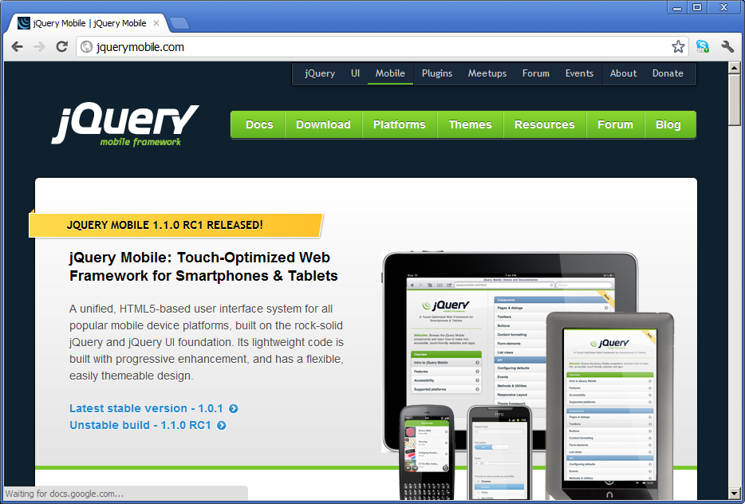
jQuery Mobile
www.jquerymobile.com
Target platform:
iOS (iPhone, iTouch, iPad)
Android
Blackberry
Windows Phone 7
Bada
Palm Web OS
Symbian
Notes:
Based on the popular jQuery and jQuery UI JavaScript libraries
Unified platform, supports all popular mobile device platforms
Pure HTML5, JavaScript, CSS

Slide 7
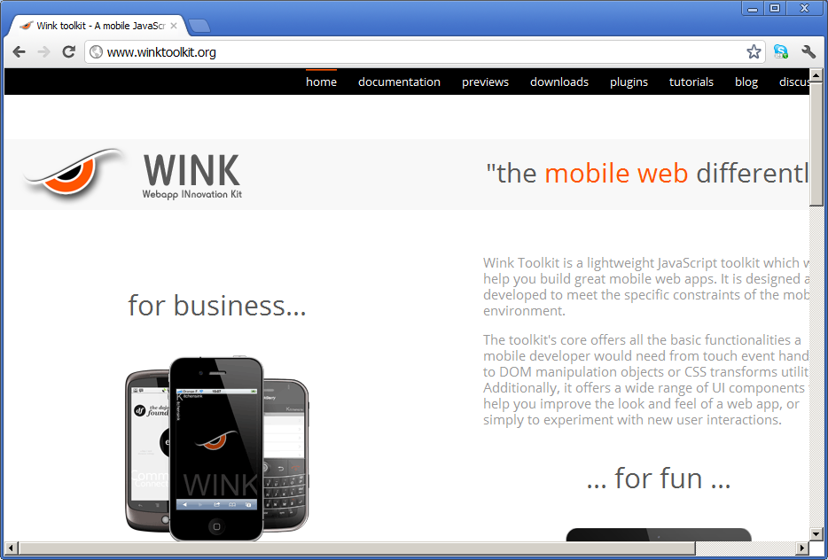
Wink Toolkit
www.winktoolkit.org
Target platform:
iOS (iPhone, iTouch, iPad)
Android
Blackberry
Windows Phone 7
Bada
Notes:
Lightweight JavaScript toolkit
Pure HTML5, JavaScript, CSS

Slide 8
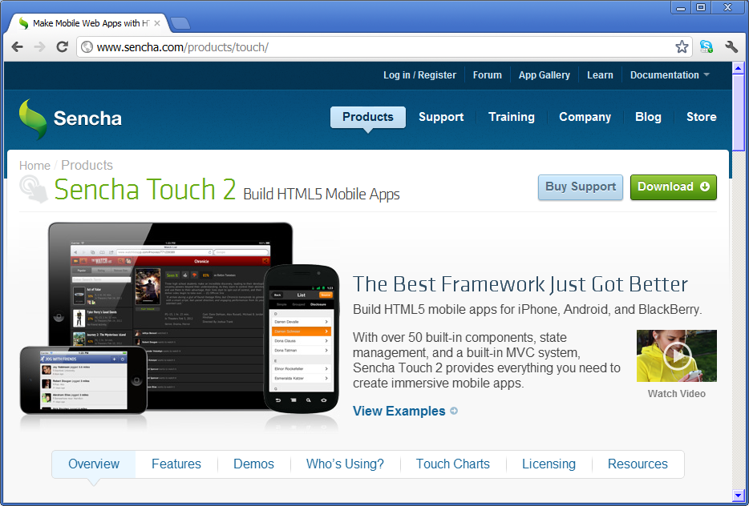
Sencha Touch
www.sencha.com/products/touch/
Target platforms:
iOS (iPhone, iTouch, iPad)
Android
Blackberry
Kindle Fire
Notes:
HTML5 framework
Provides access to native hardware features

Slide 9
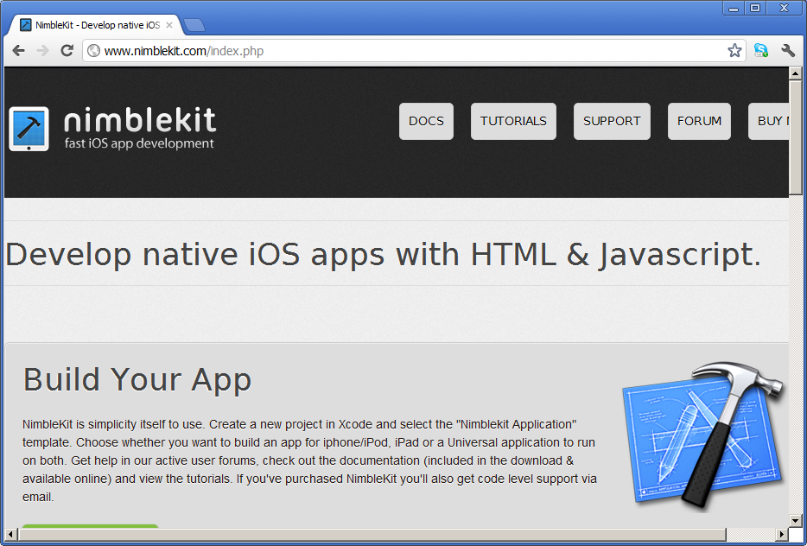
Nimblekit
www.nimblekit.com/index.php
Target platform:
iOS (iPhone, iTouch, iPad)
Notes:
Native iOS interface elements
Based on HTML5 and JavaScript
Mac development platform

Slide 10
2. Creating a Mobile User Interface
Using jQuery Mobile
Sample application
Defining pages and dialogs
Laying out a page or dialog box
Creating UI content

Slide 11
Using jQuery Mobile
jQuery mobile is very easy to use!
Link the following style sheet:
Import the following JavaScript libraries:
<link rel="stylesheet"
href="http://code.jquery.com/mobile/1.4.2/jquery.mobile-1.4.2.css" />
<script type="text/javascript"
src="http://code.jquery.com/jquery-1.11.0.js"></script>
<script type="text/javascript"
src="http://code.jquery.com/mobile/1.4.2/jquery.mobile-1.4.2.js"></script>

Slide 12
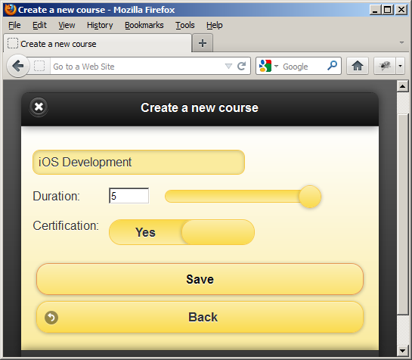
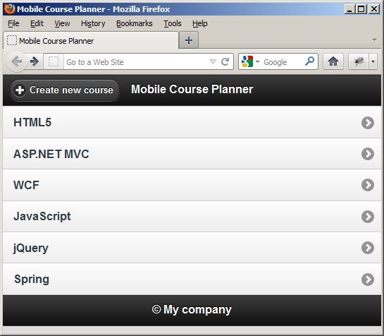
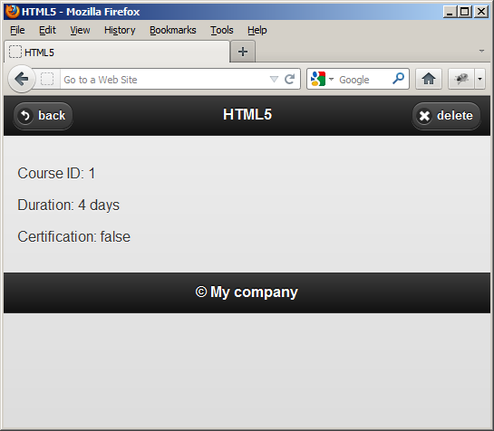
Sample Application
We're going to dissect a sample jQuery Mobile Web app
Open index.html in a browser
Appearances might vary, depending on styles / themes chosen

Slide 13
Defining Pages and Dialogs
A single HTML document can contain multiple "pages" and "dialog boxes"
Designate each one as a <div> with a distinct id
Set the data-role attribute to "page" or "dialog"
For example:
<div id="homePanel" data-role="page">
…
</div>
<div id="itemPanel" data-role="page">
…
</div>
<div id="newCoursePanel" data-role="dialog" data-theme="e">
…
</div>

Slide 14
Laying out a Page or Dialog Box
You can use data-role to define the constituent parts of a page (or dialog box)
data-role="header"
data-role="content"
data-role="footer"
For example:
<div id="homePanel" data-role="page">
<div data-role="header"> … </div>
<div data-role="content"> … </div>
<div data-role="footer"> … </div>
</div>

Slide 15
Creating UI Content
You can use data-role to tell jQuery Mobile how to display UI elements, such as:
data-role="listview"
data-role="slider"
data-role="fieldcontain"
data-role="collapsible"
data-role="collapsible-set"
Some controls have "mini" versions
data-mini="true"
You can embed standard icons anywhere you like
E.g. data-icon="plus"
E.g. data-icon="back"
E.g. data-icon="delete"

Slide 16
3. Managing Data
Overview
Setting up starter data
Using local storage
Adding items to local storage
Removing items from local storage

Slide 17
Overview
Mobile applications have unpredictable connectivity
In a worst-case scenario, a mobile app might have no connectivity at all
HTML5 local storage is ideal for mobile applications
Allows you to store data locally on the device
Retained across browser sessions
Independent of connectivity
In our sample application, all data-related code resides in data.js

Slide 18
Setting up Starter Data
Our application defines a "starter" array of course objects
var courses = [
{ id: 1, name: "HTML5", duration: 4, certification: false },
{ id: 2, name: "ASP.NET MVC", duration: 4, certification: true },
{ id: 3, name: "WCF", duration: 5, certification: true },
{ id: 4, name: "JavaScript", duration: 4, certification: true },
{ id: 6, name: "jQuery", duration: 3, certification: false },
{ id: 5, name: "Spring", duration: 5, certification: true }
];

Slide 19
Using Local Storage
On start-up, our app performs the following tasks:
Attempt to retrieve courses data from local storage (as a string)
If unavailable, store the courses into local storage (as a string)
$(document).ready(function() {
if (window.localStorage) {
var fromDb = localStorage.getItem("courses");
if (fromDb) {
// Read the courses from local storage, into the global "courses" array.
courses = JSON.parse(fromDb);
}
else {
// Store the global "courses" array into local storage.
storeCourses();
}
}
});
// Stores the global "courses" array into local storage.
function storeCourses() {
if (window.localStorage) {
localStorage.setItem("courses", JSON.stringify(courses));
}
}

Slide 20
Adding Items to Local Storage
This function allows the user to add a new course:
function addCourse(courseName, duration, certification) {
// Call a helper function to generate a unique course id (see code for details).
var newId = getNewCourseId();
// Create a new course object.
var newCourse = {
id: newId,
name: courseName,
duration: duration,
certification: certification
};
// Store the courses in the in-memory array.
courses.push(newCourse);
// Also store the courses to local storage.
storeCourses();
// Return the id of the new course (so it can be displayed in the GUI).
return newId;
}

Slide 21
Removing Items from Local Storage
This function allows the user to remove a course:
function removeCourse(id) {
// Call a helper function, to find the array index for the specified course id.
var index = getIndexForId(id);
// If the id was located…
if (index >= 0) {
// Remove the course object from the array.
courses.splice(index,1);
// Store the courses back into local storage.
storeCourses();
}
}

Slide 22
4. Implementing UI Behaviour
Overview
Initialization
Displaying the main page
Displaying the details page
Adding and removing courses
Dismissing dialog boxes

Slide 23
Overview
We need to implement the following UI behavior in our mobile application:
Populate the "main" page with a list of courses initially
Pre-populate the "detail" page with details for a course
Handle the "new course" page, to add a new course
In our sample application, all the application functionality resides in uibehaviour.js

Slide 24
Initialization
We perform the following tasks during page initialization
Note the use of jQuery syntax here ☺
$(document).ready(function() {
loadCoursesFromData();
$("#newCourseForm").submit(createNewCourse);
$("#deleteButton").click(removeSelectedCourse);
$("#backButton").click(closeDialog);
});

Slide 25
Displaying the Main Page
This function displays courses in a <ul> on main page
Creates an <li> for each course (each contains a link to the details page, i.e. #itemPanel)
We use $.mobile.changePage() to change to the main page
function loadCoursesFromData() {
// Get the list of courses and empty it.
var list = $("ul");
list.empty();
// Create <li> elements, e.g. <li><a href='#itemPanel?course=1'>HTML5</a></li>.
var template ="<li><a href='#itemPanel?course=id'>courseName</a></li>";
var listItems = "";
for (var c = 0; c < courses.length; c++) {
listItems = listItems + template.replace(/id/g, courses[c].id)
.replace(/courseName/g, courses[c].name);
}
// Assign the <li> elements to the list, and refresh its UI.
list.html(listItems);
list.listview("refresh");
// Programmatically change to the #homePanel URL, to display the main page.
$.mobile.changePage("#homePanel", {});
}

Slide 26
Displaying the Details Page (1 of 2)
jQuery Mobile allows you to intercept page changes, via the pagebeforechange event
Allows you to prepopulate the page before it becomes visible
The following code intercepts transitions to the #itemPanel page (which displays details for a course)
$(document).bind("pagebeforechange", function(e, data) {
if (typeof data.toPage === "string") {
// Get the URL that we're navigating to.
var url = $.mobile.path.parseUrl(data.toPage);
// Compare the # part of the URL to see if it's the "#itemPanel" page.
if (url.hash.search(/^#itemPanel/) !== -1) {
// Populate the #itemPanel with data for the selected course.
showCourse(url, data.options);
e.preventDefault();
}
}
});

Slide 27
Displaying the Details Page (2 of 2)
The following code populates the #itemPanel page
function showCourse(urlObj, options) {
// Get the course id (after the "#itemPanel?course=" part of the URL).
var courseId = urlObj.hash.replace(/.*course=/, "");
if (courseId) {
selectedCourseId = courseId;
var course = getCourseById(selectedCourseId);
$("#headerField").html(course.name);
$("#idField").html("Course ID: " + course.id);
$("#durationField").html("Duration: " + course.duration + " days");
$("#certificationField").html("Certification: " + course.certification);
// Get the page to display (via everything up to the ? in the URL).
var pageSelector = urlObj.hash.replace(/\?.*$/, "");
var thePage = $(pageSelector);
// Call jQuery Mobile page() function, to convert HTML into nice mobile format.
thePage.page();
// Now do the page change.
options.dataUrl = urlObj.href;
$.mobile.changePage(thePage, options);
}
}

Slide 28
Adding and Removing Courses
This function adds a course:
This function removes a course:
function createNewCourse(e) {
e.preventDefault();
var name = document.getElementById("newNameField").value;
var duration = document.getElementById("newDurationField").value;
var certification = document.getElementById("newCertificationField").value;
addCourse(name, duration, certification);
loadCoursesFromData();
document.getElementById("newNameField").value = "";
}
function removeSelectedCourse() {
removeCourse(selectedCourseId);
loadCoursesFromData();
}

Slide 29
Dismissing Dialog Boxes
This function dismisses dialog boxes if the user clicks the "Back" button
function closeDialog() {
$(".ui-dialog").dialog("close");
}

Slide 30
Any Questions?

